Slide 1



Hello and Welcome to
AI Camp

Slide 2
Nature Language Processing
Simplfied

Slide 3




Table of Content :
• A gentile introduction to NLP
What NLP IS ?
What Can NLP DO ?
What Text Data is ?

Slide 4


Table of Content :
• A gentile introduction to NLP
• How to Prepare your Data ?
• Text Cleaning
• How to transform into and Why ?
• Resources we highly recommend for NLP

Slide 5

SESSION TIME LINE :
Problem
Solution
Define NLP
Tasks
Techniques
Data Cleaning
Practice
Data Preparation
Techniques
Text Data
Word
Embedding
Practice

Slide 6
After This Workshop you should be able to:
• Define What NLP
• Enumerate NLP tasks
• Clean your text Data
• know How & why we to transform into and why ?

Slide 7
A Gentile Introduction to NLP

Slide 8
What NLP IS ?

Slide 9
What NLP IS ?
Problem

Slide 10











What NLP IS ?
E-Commerce
Store
Tasks
Understanding humans language
Computers
Solution
Automatic
Automation

Slide 11




What NLP IS ?
+
=
Computers
Numbers
Good
Results
+
=
Computers
Human Language
(Nature Language)
Bad
Results
(Without Programming)

Slide 12
What NLP IS ?
• Computers perform well on numbers Language
(Math/computing/logique)
• Computers perform bad on Humans Language
(understanding/speaking/reading/writing)

Slide 13



What NLP IS ?
• Computers perform bad on Humans Language
(understanding/speaking/reading/writing)
Mission : WE NEED TO SOLVE THIS PROBLEM

Slide 14
What NLP IS ?
SOLUTION

Slide 15


What NLP IS ?
+
=
Computers understand Humans
Computers
NLP
Model
(Without Programming)
=
+
Computers
Human Language
(Nature Language)
Good
Results

Slide 16
What NLP IS ?
Nature Language Processing

Slide 17




What NLP IS ?
Sub field of ai
Read
Gives
NLP
The Ability to
Write
Understand
Computers
to
By
training
perform
Nature language
(Human Language)
NLP Model
(Language Model)
Human Tasks

Slide 18

SESSION TIME LINE :
Problem
Solution
Define NLP
Tasks
Techniques
Data Cleaning
Practice
Data Preparation
Techniques
Text Data
Word
Embedding
Practice

Slide 19
What can we do with NLP ?

Slide 20
What are the tasks that we can perform using NLP ?

Slide 21

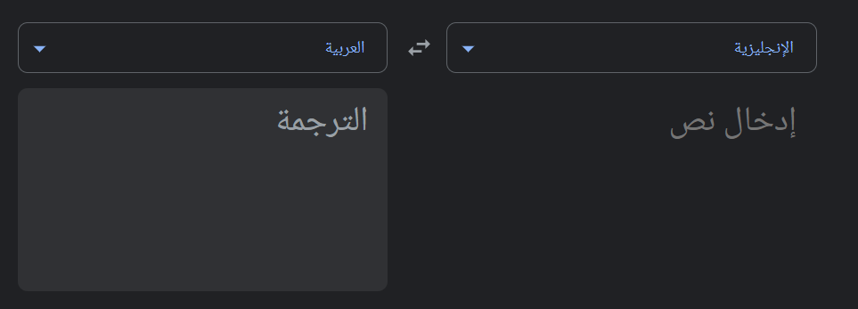
Transalation

Slide 22


Transalation
Sentiment
Analysis
Negative sentiment
« I Hate Israel»
+
=

Slide 23

Transalation
Sentiment
Analysis
Summarization

Slide 24

Transalation
Sentiment
Analysis
Summarization
Conversation
«Hello i’m Unes»
=
«Hi Unes, how are you doing today !»
+

Slide 25


Transalation
Sentiment
Analysis
Summarization
Text
Generation
Conversation
Story about gaza
«Generate a story about gaza »
+
=

Slide 26

Transalation
Sentiment
Analysis
Question
Answering
Summarization
Text
Generation
Conversation
«Do you support palastine ?»
«YES I DO SUPPORT PALASTINE»
+
=

Slide 27

Transalation
Sentiment
Analysis
Segmentation
Question
Answering
Summarization
Text
Generation
Conversation
I =) Pronoun
Hate =) Verb
Israel =) Noun
« I hate israel »
+
=

Slide 28
Transalation
Sentiment
Analysis
Segmentation
Question
Answering
Summarization
Text
Generation
Conversation
ChatGPT

Slide 29
SESSION TIME LINE :
Problem
Solution
Define NLP
Tasks
Techniques
Data Cleaning
Practice
Data Preparation
Techniques
Text Data
Word
Embedding
Practice

Slide 30
What Text Data is ?

Slide 31


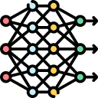
Text Data
We want to create a
For
+
=
Text Data
The Most Important

Slide 32




Text Data
We want to create a
For
@#$%^&*()
Example.com
16/07/2004
🌟 & 😊
" - , …
Aberiviations : « ie.»
acronyms
My nAme IS UnEs
automate, automatic, automation
Collect
Web

Slide 33
Text Cleaning

Slide 34


Text Cleaning
Technique
Uncleaned data
@#$%^&*()
Example.com
16/07/2004
🌟 & 😊
" - , …
Aberiviations : « ie.»
Acronyms : NASA
My nAme IS UnEs
be
Color
automat
Meet
am, are, is
Colors , Color
automate, automatic, automation
Meeting -) verb / Meeting -) noun
Stemming
Lemmitization

Slide 35
Text Cleaning
Stemming
VS
Lemmitization
Finally, final, finalized

Slide 36
Text Cleaning
Stemming
VS
Lemmitization
obtain a root form.
faster and simpler
Fina
less accurate
aggressive approach
Finally, final, finalized
Obtain their base
Slower
Final
More accurate
Form Dictionary

Slide 37
Text Cleaning
Tokenization

Slide 38
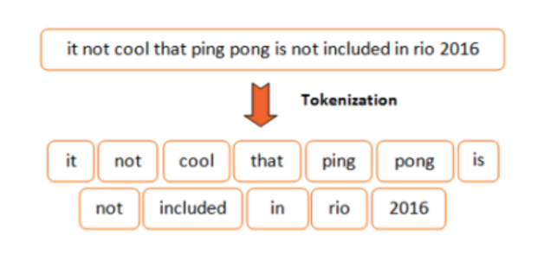
Text Cleaning
Tokenization
Tokens
meaningful small units

Slide 39
CODING TIME !

Slide 40


CODING TIME !

Slide 41
SESSION TIME LINE :
Problem
Solution
Define NLP
Tasks
Techniques
Data Cleaning
Practice
Data Preparation
Techniques
Text Data
Word
Embedding
Practice

Slide 42
Word Embeddings

Slide 43
How to transform into and Why ?

Slide 44
Bag of words

Slide 45


Bag of words
Unes
10
Loves
3
Not the Best
Method
Palastine
5.9
Example :
It Kills the words Meanings
(Random)
First attempt : Unes 5
Second attempt : Une 999999

Slide 46
Bag of words
Unes
10
Loves
3
Not the Best
Method
Palastine
5.9
Example :
It Kills words Meanings
(Random)
Isreal 5.099
Pigs 5.1
Isreal 5.099
Similar Words should have similar values
Pigs 24554

Slide 47
Bag of words

Slide 48
Bag of words
Word2Vec

Slide 49
Bag of words
Word2Vec

Slide 50
Word2Vec

Slide 51
Word2Vec
Words : [King – Queen - Women – Man – Horse – Battle – Castle – Donkey - ]
 | Queen | Woman | Man | Horse | Battle | Castle | Donkey | King
Authority | 0.9 | 0.2 | 0.35 | 0 | 0 | 0 | 0 | 1
Gender | -1 | -1 | 1 | 1 | 0 | 0 | 1 | 1
Event | 0 | 0 | 0 | 0 | 1 | 0 | 0 | 0
Rich | 0.8 | 0.3 | 0.5 | 0 | 0 | 0 | 0 | 1
Has tail ? | 0 | 0 | 0 | 0 | 0 | 0 | 1 | 0
Speaks ? | 1 | 1 | 1 | 0 | 0 | 0 | 0 | 1
Building ? | 0 | 0 | 0 | 0 | 0 | 1 | 0 | 0

Slide 52
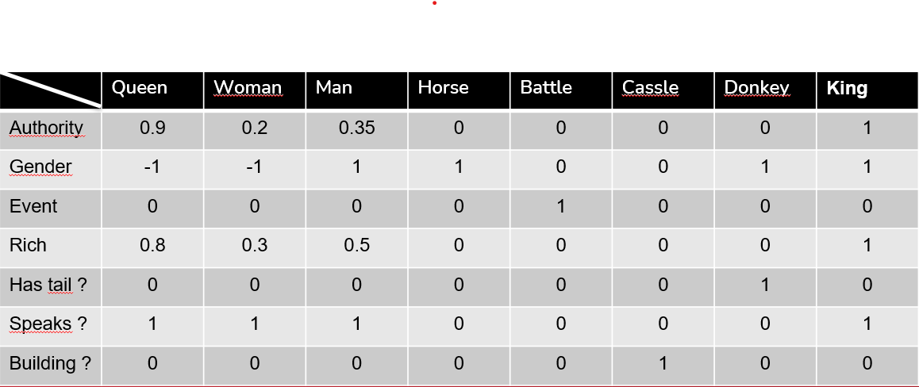
Word2Vec
Words : [King – Queen - Woman – Man – Horse – Battle – Cassle – Donkey ]
Features
Queen = [0.9,-1,0,0.8,0,1,0] = 0.9 -1 +0 +0.8 +0 + 1 + 0 = 1.7
Women = [0.2,-1,0,0.3,1] = 0.2 -1 +0.3 + 1 = 0.5
Man = [0.35,1,0.5,1] = 1 + 1 + 0.35 + 0.5 = 2.8
King= [1,1,0,1,0,1,0] = 1 + 1 + 1 + 1 = 4
Horse = 1
Donkey = 1
The More features
The More values
are optimized

Slide 53
Word2Vec
Words : [King – Queen - Woman – Man – Horse – Battle – Cassle – Donkey ]
More Features:
- Beard ?
- Clothes ?
- food ?
- fly ?
Features
Queen = 1.7
Women = 0.5
Man = 2.8
King = 4
Horse = 1
Donkey = 1
Queen = 1.63
Women = 1.24
Man = 2.1
King = 2.4
Horse = 0.2
Donkey = 0.19
Optimization

Slide 54
Word2Vec
Words : [King – Queen - Woman – Man – Horse – Battle – Cassle – Donkey ]
Queen = 1.7
Women = 0.5
Man = 2.8
King = 4
Horse = 1
Donkey = 1
Queen – Women + Man = 1.7 – 0.5 + 2.8 = 4 King = 4
King – Man + Women = 4 – 2.8 + 0.5 = 1.7 Queen = 1.7

Slide 55








Word2Vec
More Examples :
+
-
=
-
+
=

Slide 56
Word2Vec
Randomness
Words has meanings
-
=
+

Slide 57
But There is a Problem ?

Slide 58
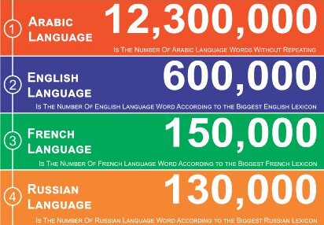


But There is a Problem ?
100000 Features
English : 600,000 * 100,000 = 60,000,000,000 cases
Arabic : 12,300,000 * 100,000 = 1,230,000,000,000 cases

Slide 59
Solution ?

Slide 60

Solution ?
Deep Learning

Slide 61
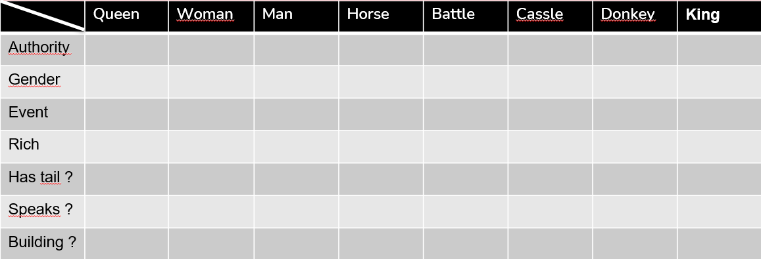
OUR PLAN :
+
=
Should Understand the words meanings Assign Meaningful numbers
Skip Grams
How We Train ?
CBOW (Continuos Bag of Words)

Slide 62
Unes Loves Palastine

Slide 63
Unes Loves Palastine
SkipGrams
CBOW (Continuos Bag of Words)
[X] Loves [X]
Unes [X] Palastine
Task : We want to predict the target word using the surrounding words
Target : Loves ([X])
Context : Surrouning words
Task : We want to predict Surrouning words using the target word
Target : Loves ([X])
Context : Surrouning words
Training Samples
=
Training Samples
=
+
+
Unes
Palastine
+
=
Loves
[X] Loves [X]
Unes [X] Palastine
+
=

Slide 64
Younes is Stands with Palastine and Hates Israel So much
Frame = 2
Skip Grams
Inputs : stands with (left)
and hates (right)
Output : Palastine
Younes is Stands with [X] and Hates Israel So much
CBOW
Input: Palastine
Outputs : stands with (left)
and hates (right)
Younes is [X] Palastine [X] Israel So much

Slide 65
Younes is Stands with Palastine and Hates Israel So much
Frame = 2/3 . . . .
Skip Grams
Inputs : stands with (left)
and hates (right)
Output : Palastine
Younes is Stands with [X] and Hates Israel So much
CBOW
Input: Palastine
Outputs : stands with (left)
and hates (right)
Younes is [X] Palastine [X] Israel So much

Slide 66
Younes is Stands with Palastine and Hates Israel So much
Give
Skip Grams
CBOW
Can assign accurate Values
Understands the word meanings

Slide 67
SESSION TIME LINE :
Problem
Solution
Define NLP
Tasks
Techniques
Data Cleaning
Practice
Data Preparation
Techniques
Text Data
Word
Embedding
Practice

Slide 68
Any Questions ?

Slide 69
Thank you for your attendance !!

